Slide 1
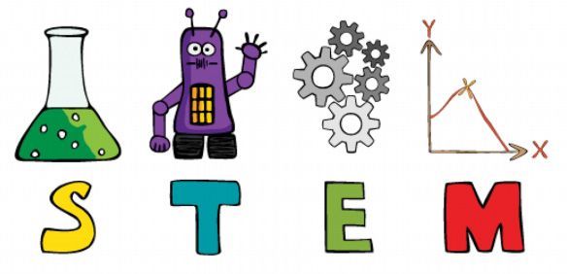
Club Imagination
Force & Motion

Slide 2
Sir Isaac Newton

Slide 3
Newton’s
Laws
Newton’s First Law:
An object at rest will remain at rest unless acted on by an unbalanced force. An object in motion continues in motion with the same speed and in the same direction unless acted upon by an unbalanced force.

Slide 4
Newton’s First Law:
An object at rest will remain at rest unless acted on by an unbalanced force. An object in motion continues in motion with the same speed and in the same direction unless acted upon by an unbalanced force.
What Does This Mean?
Objects keep doing what they are doing until an outside force changes them.
An object that is moving keeps moving (until acted on by an outside force).
An object at rest stays at rest (until acted on by an outside force).

Slide 5
Newton’s First Law:
Objects keep doing what they are doing.
An object that is moving keeps moving (until acted on by an outside force).
An object at rest stays at rest (until acted on by an outside force).

Slide 6
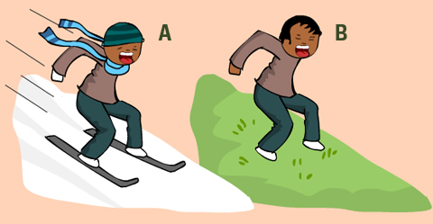
What Is a Force?
A force is a push or pull.
Two important forces that slow down and stop objects are gravity and friction.

Slide 7
Friction
Friction is a force that stops things from moving easily. Whenever an object moves or rubs against another object, it feels frictional forces. These forces act in the opposite direction to the movement. Friction makes it harder for things to move.
In the picture below, the boy on the grass is having difficulty sliding, because the grass is not smooth and his shoes are getting stuck in the grass. There is more friction between the shoes and the grass than the snow and the skis.
More
Friction
Less
Friction

Slide 8
Newton’s
Laws
Newton’s Second Law:
If you place a force on an object, it will move faster in the direction of the force.

Slide 9
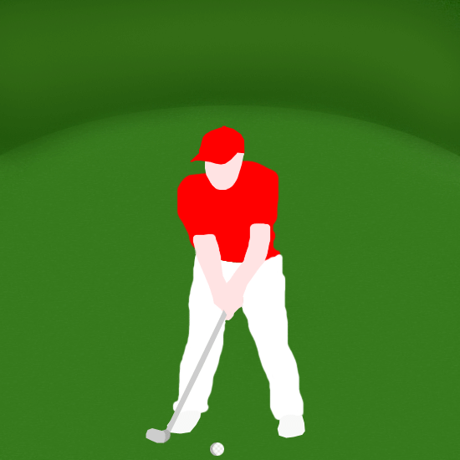
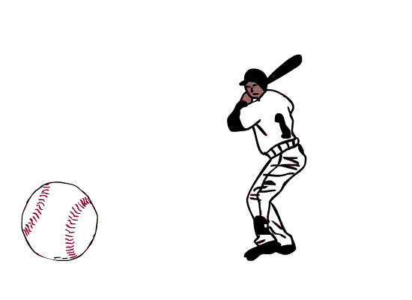
Newton’s Second Law:
If you place a force on an object, it will move faster in the direction of the force.
The stronger the force, the greater the movement of the object

Slide 10
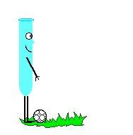
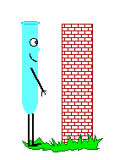
Newton’s Second Law:
If you place a force on an object, it will move faster in the direction of the force.
The stronger the force, the greater the movement of the object
BUT... the greater the mass of the object, the greater the amount of force needed to move the object

Slide 11
Goals – Day One:
Use Newton’s Laws, force, friction, and gravity to make a ball start moving and stop moving.
Design and make a simple machine to apply a force to a ball and make it move.
Test how different surfaces create more or less friction and change the movement of the ball.
Test your machine using balls with different masses, sizes, and textures.

