Slide 1
3D Printing
By Sherman Ortiz

Slide 2
History
1984 Invented by Chuck Hull 1988 Technology available to public 2020 Bio printing expected to be perfected.

Slide 3
What Is 3D Printing?
The layering of 2D layers until they have been turned into a 3D object
Additive Manufacture is the technology of printing physical 3D objects from digital data

Slide 4
Materials
Plastic Glass Metal Polymers Human Tissue Wax Edible Food Sand and glue mixes etc...

Slide 5
Human Tissue(Bio Printing)
May not need a donor for organs in the future.
Will provide on-demand Human Tissue
Use for drug testing for medicine on human tissue created.
Materials used to print organs, are the live tissue/cells from the person it is meant for. Combines like jell.
Blood vessels can currently be printed.

Slide 6
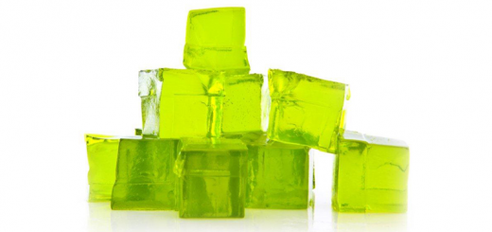
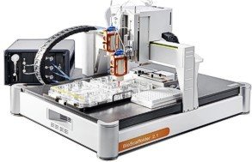
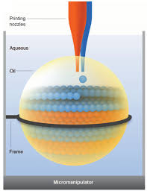
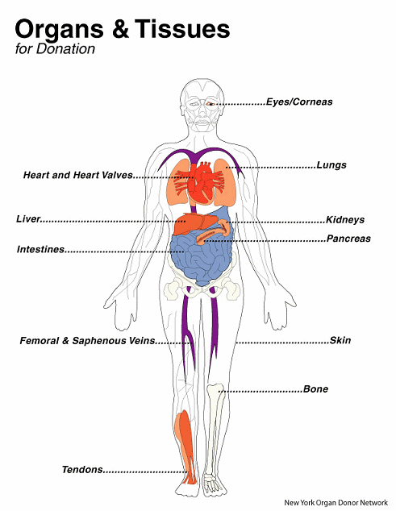
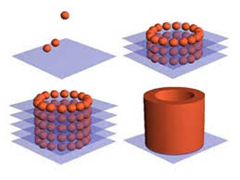
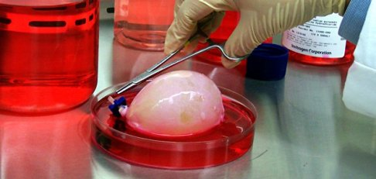
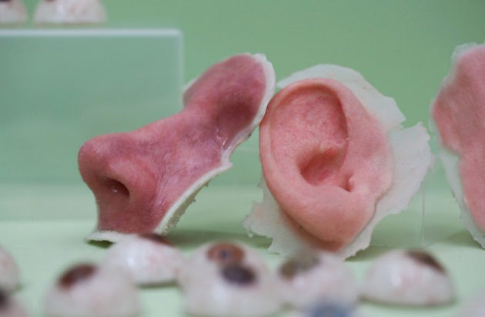
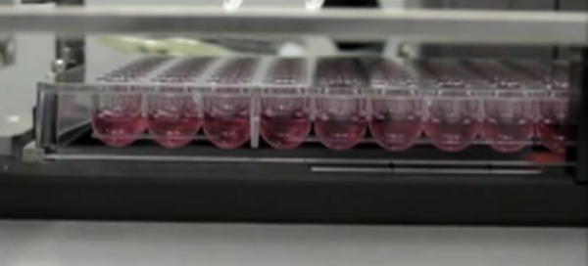
Human Tissue(Bio Printing)

Slide 7
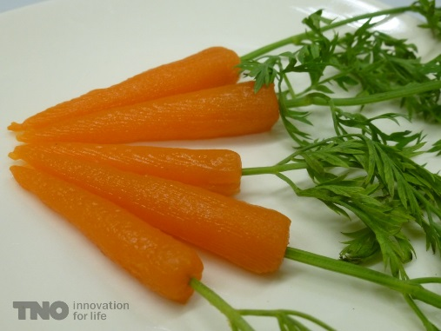
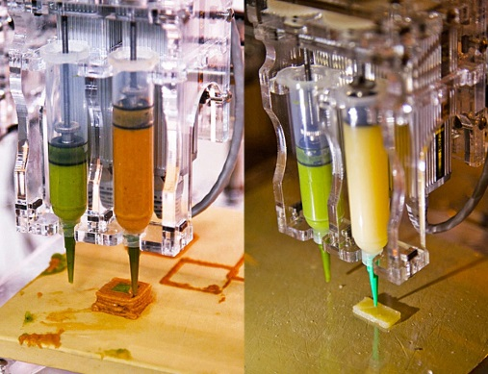
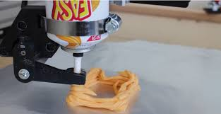
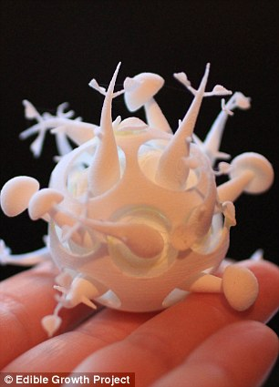
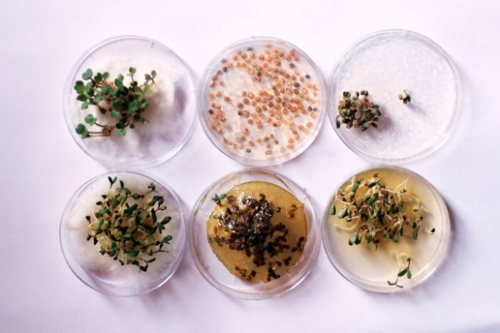
Food Printer
Difference between edible objects and food
Base making for Cooking.

Slide 8
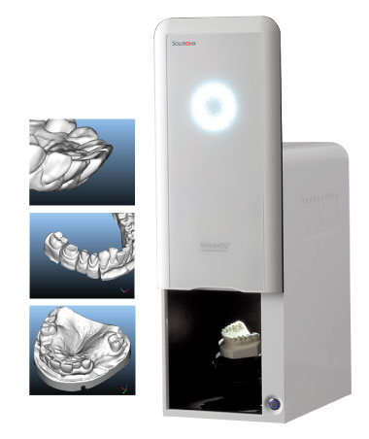
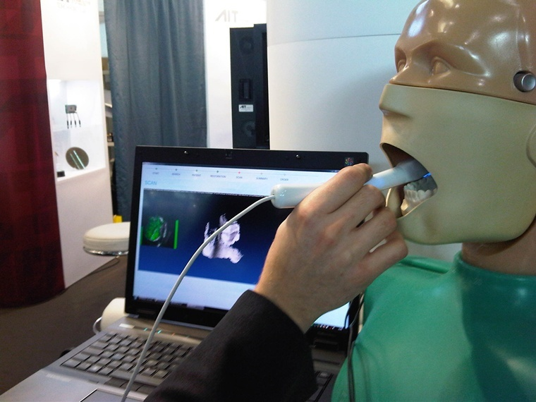
Dental Printing

Slide 9
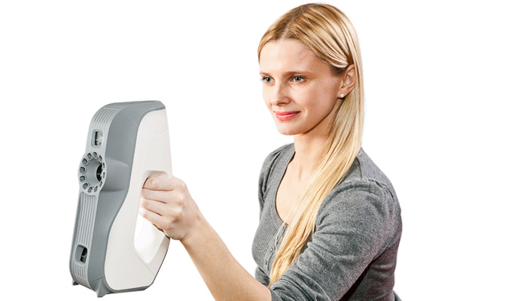
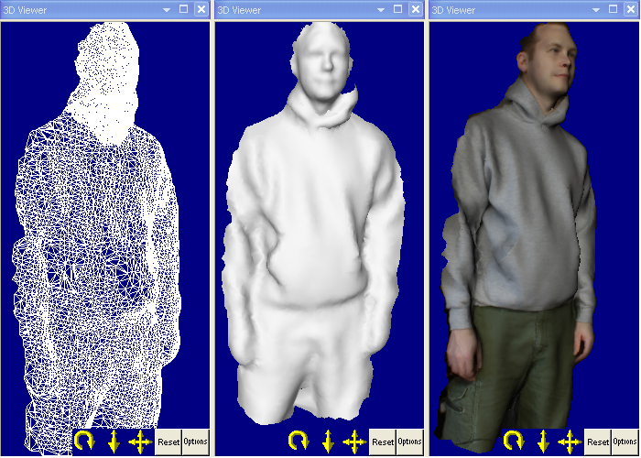
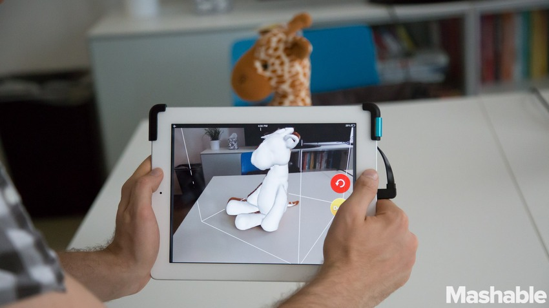
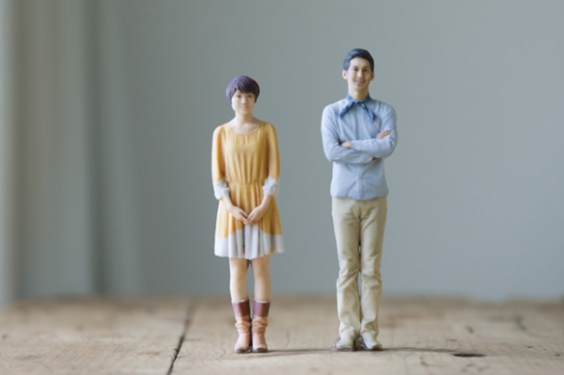
Scanners
Hoping to be used to design wearable limbs that are more precise and make life easier.

Slide 10
Programs CAD (Computer Aided Design)
Auto CAD: New Version
Cinema 4D
Rhino: design 2D and 3D objects in a space
LightWave
Maya (Autodesk 3D (NewTek)
3ds Max (Autodesk)

Slide 11
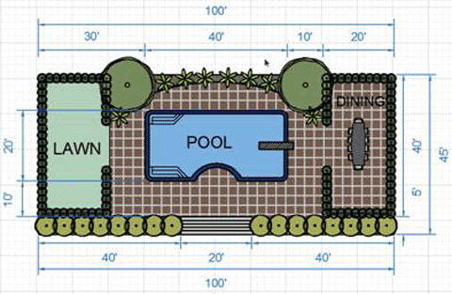
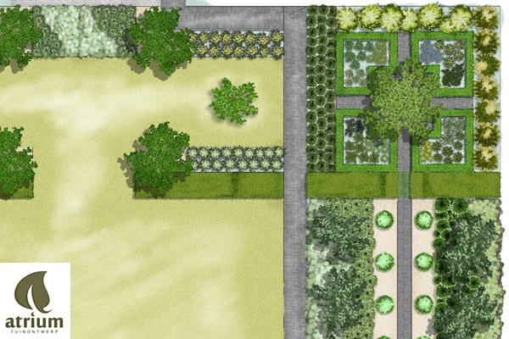
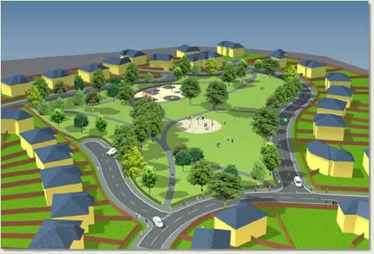
Auto Cad
Start by designing 2d object first and add detail afterwards

Slide 12
Information You Should Know
100% fill vs 10 fill.
Supports and Rafts removable material that makes sure.
Charging per a gram adds up quick
Think of the printer. - Materials such as wood, leather…etc
This will save you time and money.

Slide 13
Buying One
Prices typically in the range of $250 – $2,500.
When purchasing make shore you are aware of the filament it uses Price of the filament and if it accepts only that filament.

Slide 14
TinkerCad
Go online and think in Tinker CAD Sign In (Shapes / Inserting)
You will start a basic understanding of 3D design. (Open up illustrator is have a good understanding of adobe products)

Slide 15
Questions to Ask Yourself:
Is it a hands-on activity?
Is the end product:
Fun?
Attractive?
Useful?
Educational?
Does the toy allow kids to modify the design of their creation or come up with their own?
Can it be used in more than one way or expanded upon?
Does it introduce real-world skills or concepts that kids can build on as they grow?
Will it inspire kids to take on more challenges and seek out other opportunities for making?

