Slide 1
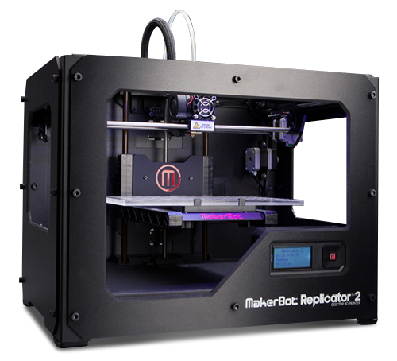
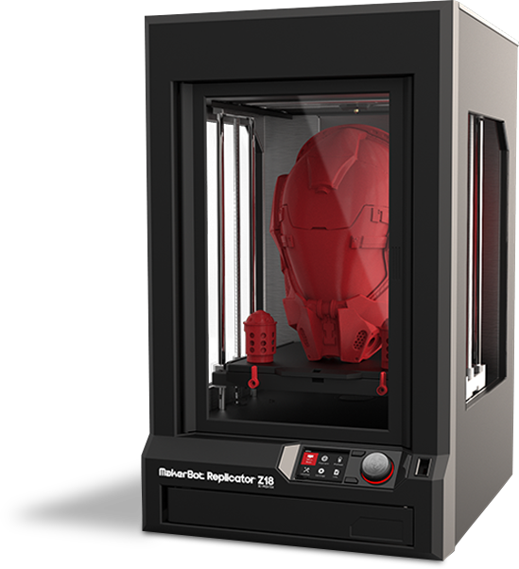
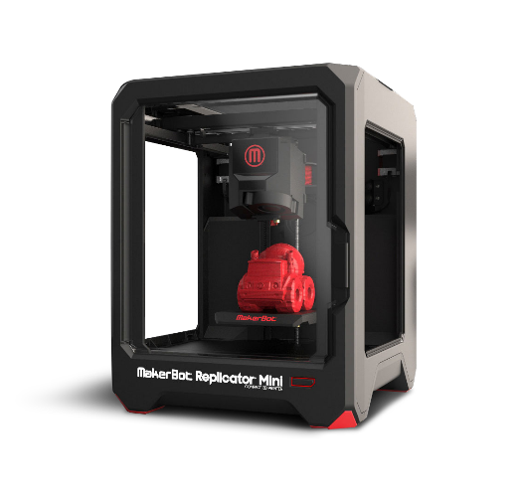
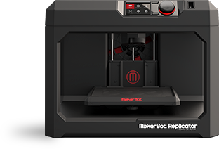
Tinker CAD Lesson
STEM LAB Sherman Ortiz

Slide 2
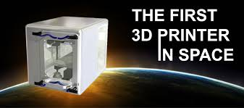
WORK SPACE
This is your work area.
Right click: To look around object.
Left click: - drag objects inside workspace - resize/move object

Slide 3
Shapes
Shapes are the basic building blocks of Tinkercad. Any shape can add or remove material, and you can also import or create your own shapes.

Slide 4
Copy and Paste
“Ctrl” + “C” – Copy
“Ctrl” + “V” – Paste
“Ctrl” + “Shift” + “V” – Paste in line

Slide 5
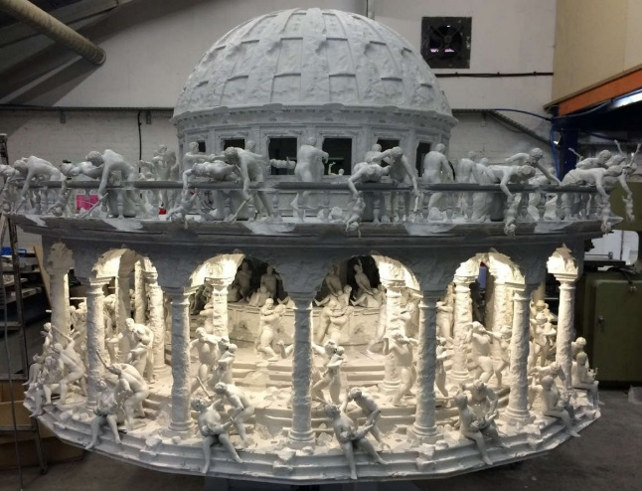
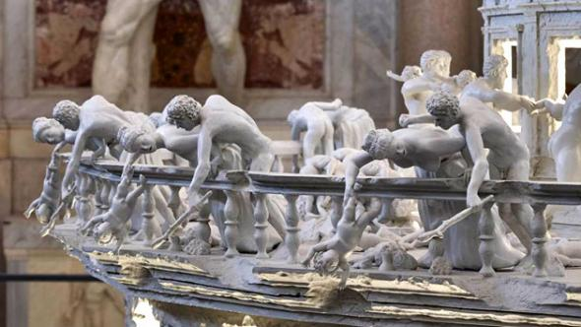
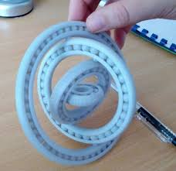
Rotation
Click on the arrows to rotate different fields of the work space
“Click” + “Shift” – Move In 45 / 90 degree angles

Slide 6
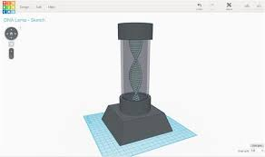
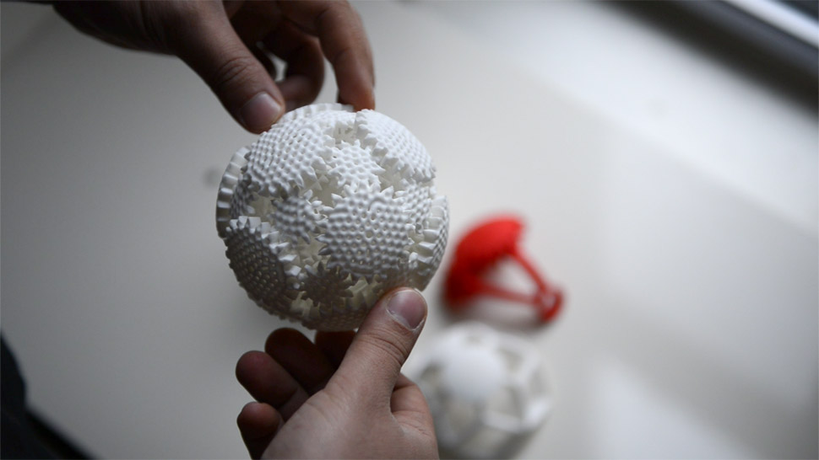
Grouping
Click on Group on top To join your objects together
Ungroup will ungroup the last group link to them.

Slide 7
Grouping
By grouping together a set of shapes you can create new models to work with. Build intricate shapes and create extremely detailed models.

Slide 8
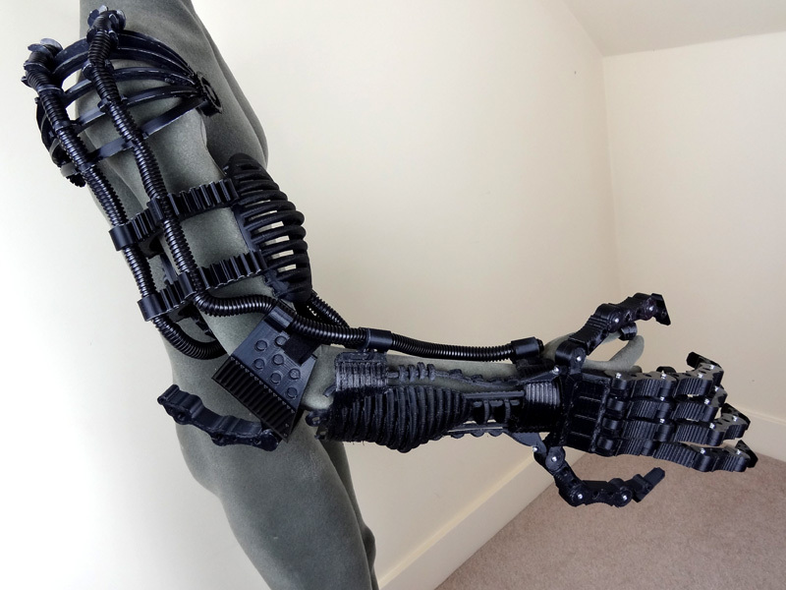
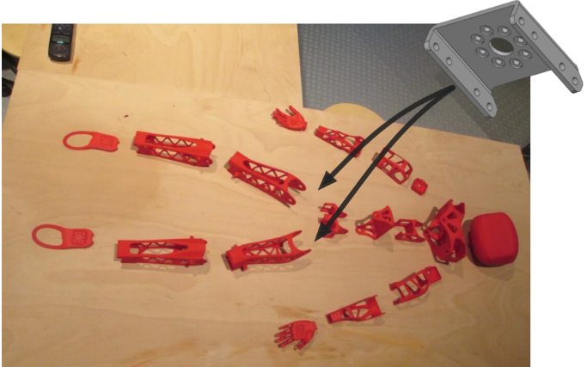
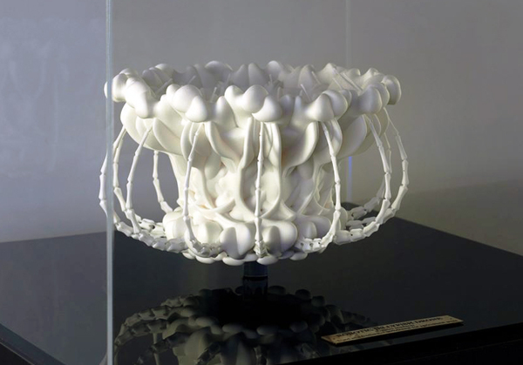
Undo and adjust
Undo: If error occurs press undo on top or (“Ctrl”+ “Z”)
Adjust: Select All your object you wish to adjust -click the way you wish to adjust them.

Slide 9
Import 2D and 3D
Create vector shapes, then import and extrude them into 3D models. Additionally, you can import external 3D files which become editable Tinkercad shapes

Slide 10
IPad Pre-scan 123D Catch
Turn ordinary photos into extraordinary 3D models.
Capture places, people and things in 3D using your Windows Phone or Mobile device, iPhone, iPad, Android device, or any camera. Share your catches, or 3D print a real object!

Slide 11
Thank You For Coming
STEM LAB 2015

