Slide 1
Welcome to Club Imagination.
SUNY Cobleskill, July 11-15, 2016

Slide 2
Introductions
Your Instructors
Your Head Counselors
Your Counselors
And…

Slide 3
YOU!!!!
Stand up and cheer if you were here last year.
Stand up and wave if this is your first time at STEM Camp.

Slide 4
Let’s take a look at your day at camp…
8 a.m. Arrive and Play at Bouck Gym
8:20ish Walk to Wheeler 100
8:30 Camp Meeting
9:00 Time with your group: Roller Coaster Science!
11:45 Head to lunch! Also…Play time and Tours
2:00 Back to the Lab!
3:30 Wrap it up, head back to Bouck for Play and Pickup

Slide 5
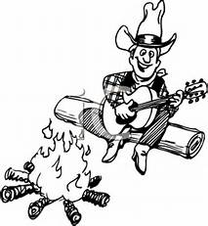
But first….. we sing!
(This is Summer Camp, after all!)

Slide 6
Hello.
My name is Joe.
I’ve got a house, 3 kids and 1 spouse.
And I work in a button factory.
And one day, my boss came up to me and he said,
“Hey Joe, are you busy?”
I said, “No.”
“Can you hit this button with your _____________ ?”

Slide 7
FROGGIES!!!! A repeat song.
Dog. Dog, cat. Dog, cat biiiiiiird.
Froggy! Itsy bitsy teeny weenie little greeny froggy. Jump high,
catch a fly cute little froggy.
A juuump, a juuump, a jump
little froggy. Ribbit ribbit croak,
ribbit croak, ribbit ribbit croak.

Slide 8
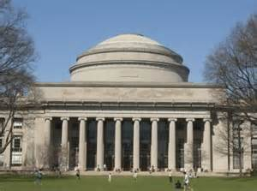
MIT Fight Cheer
I'm a Beaver, you're a Beaver, we are Beavers all. And when we get together, we do the Beaver call!
E to the U du dx, E to the X dx. Cosine, secant, tangent, sine, 3.14159. Integral radical mu dv Slipstick, sliderule, MIT!

Slide 9
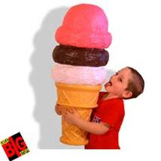
Now we need to talk about LUNCH…
Lunch Rules Powerpoint

Slide 10
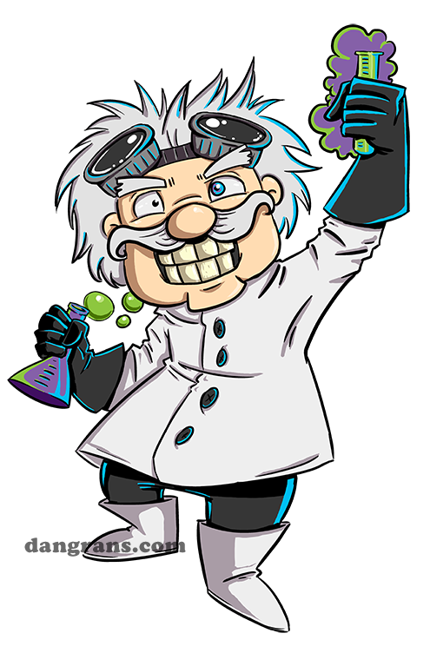
NOW TO THE LAB !!!!!
Roar!!! Mr. Beekman
Holmes 228 & 131
Firecrackers!!!
Mrs. Hanes Wheeler 107
Anacondas!!!
Mrs. Elder Wheeler 109
Boomerangs!!!
Mrs. Billington Wheeler 131

