Slide 1
Club Imagination
Golf Course Design

Slide 2
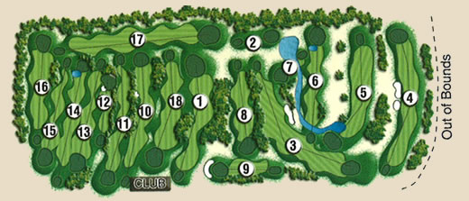
Golf Course Design
Most golf courses have 18 holes
Each hole has a unique shape and different features
Check out these 18-hole courses:
What are some things you notice?

Slide 3
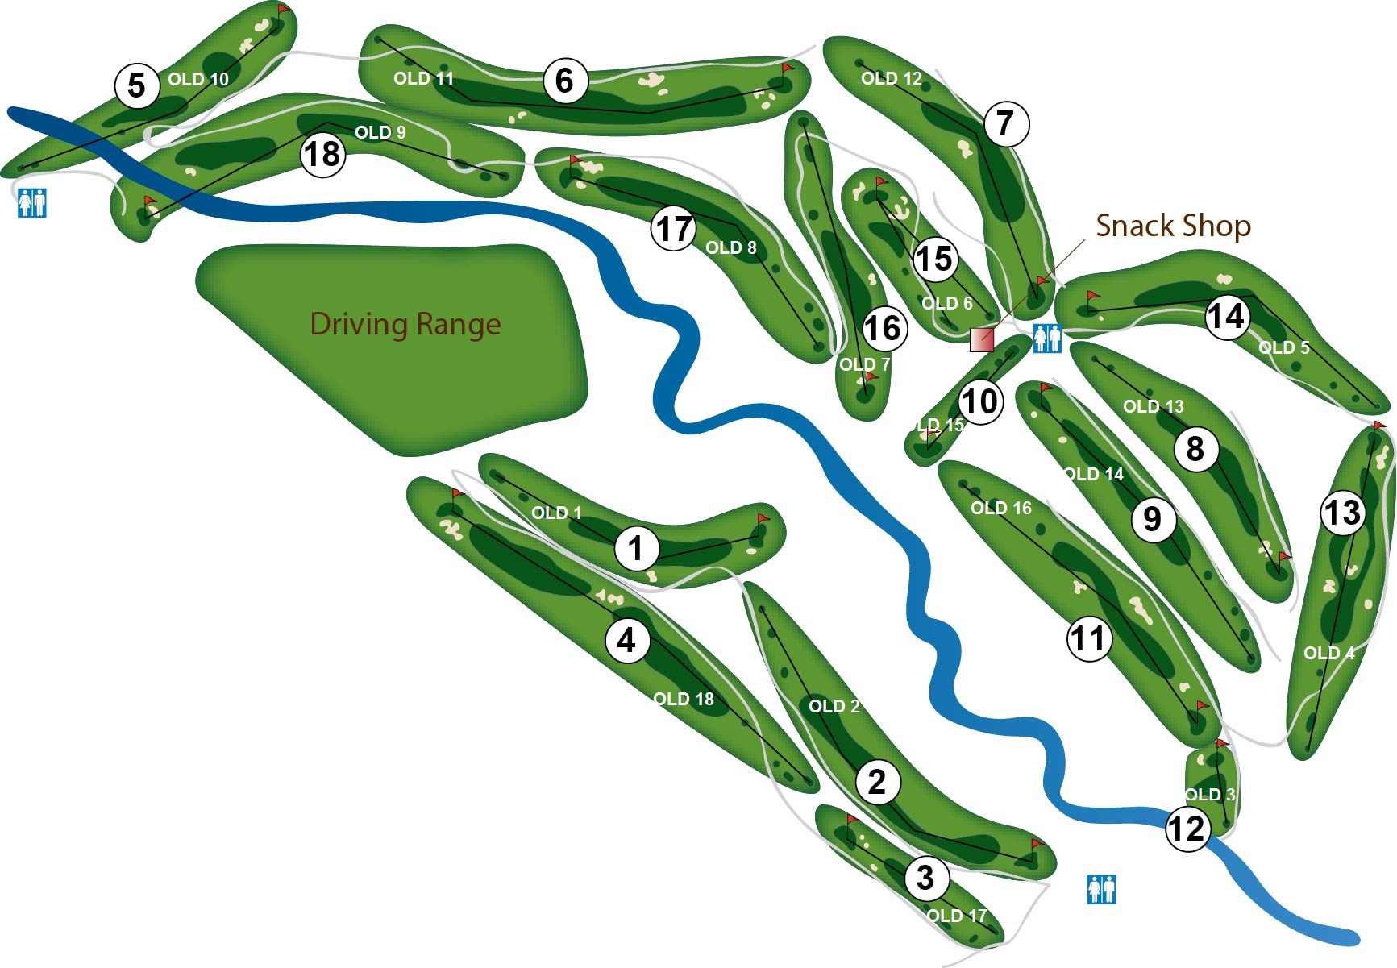

Slide 4
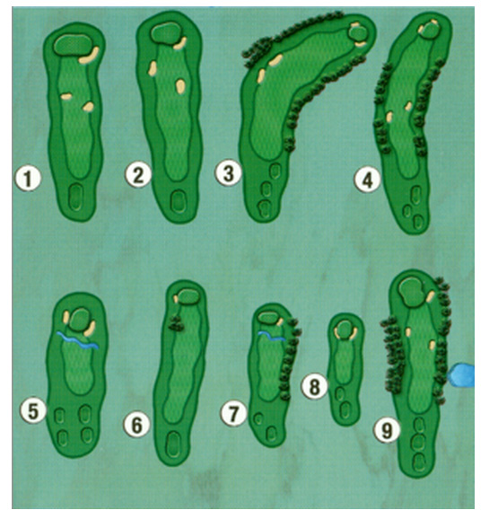

Slide 5
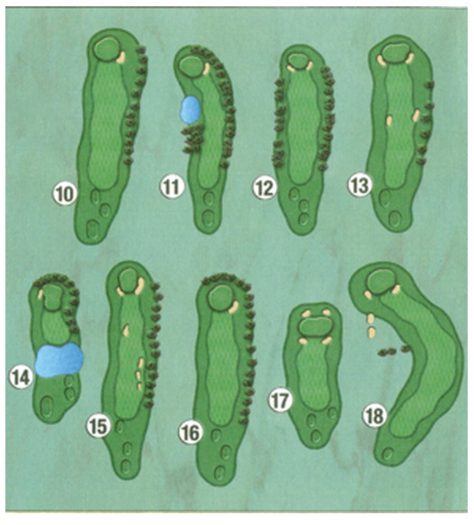

Slide 6
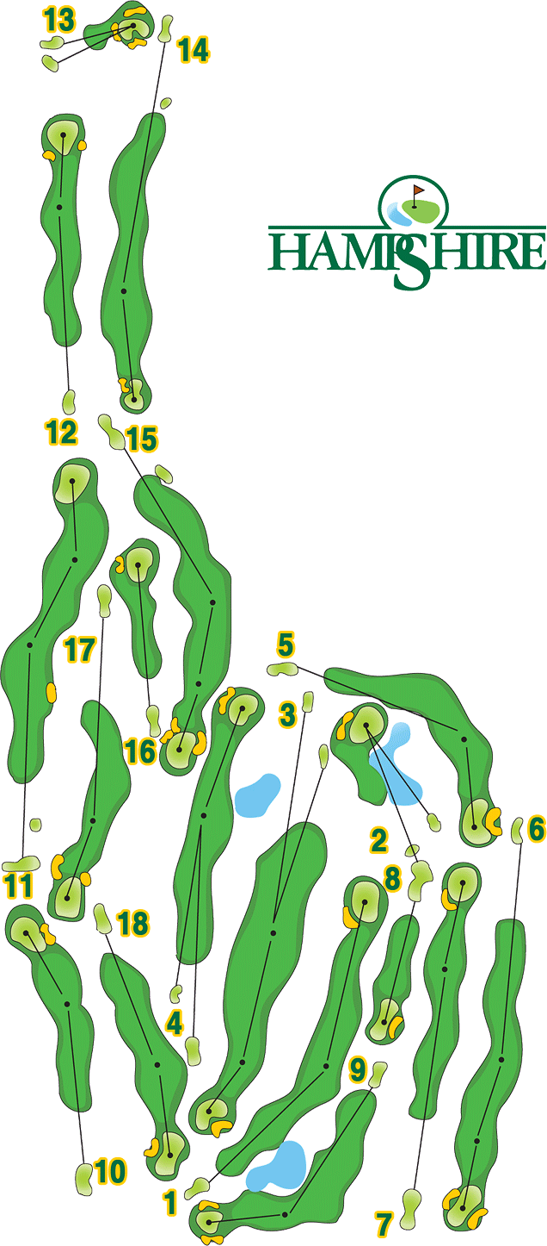

Slide 7
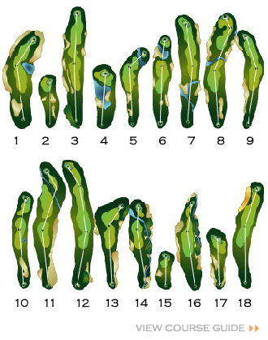

Slide 8
Golf Course Design
Each hole is designed differently depending on the shape of the land.
Most holes have some common features.
What do you notice?

Slide 9
Golf Course Design
Tee (where you start from)
Hazards
(such as sand traps, water, and trees)
Green
(smooth, short grass near the hole)
Rough
(thicker grass surrounding
the fairway)
Fairway
(the safest path
toward the hole)

Slide 10
Can you find these features:
green
fairway
rough
hazards
tees
Many holes have more than one tee area.
Can you guess why?

Slide 11
Can you find these features:
green
fairway
rough
hazards
tees
Golf holes are designed so many different types of players can play (experts, beginners, adults, kids, senior citizens).

Slide 12
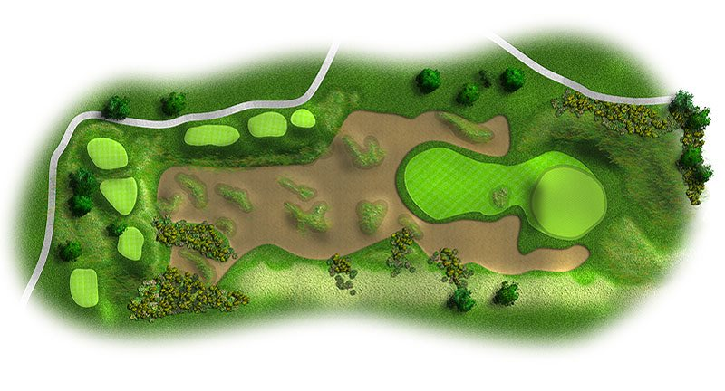
Look for the features:
green
fairway
rough
hazards
tee(s)

Slide 13
Some holes have complicated hazards

Slide 14
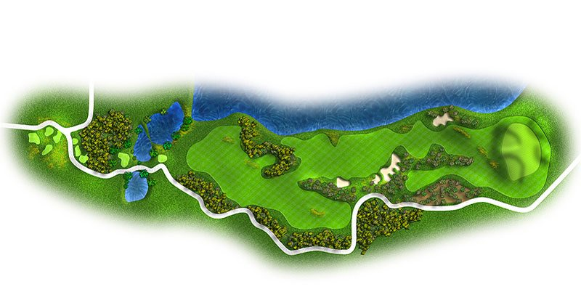
Some holes have complicated hazards

Slide 15
Some holes have more than one kind of hazard.

Slide 16
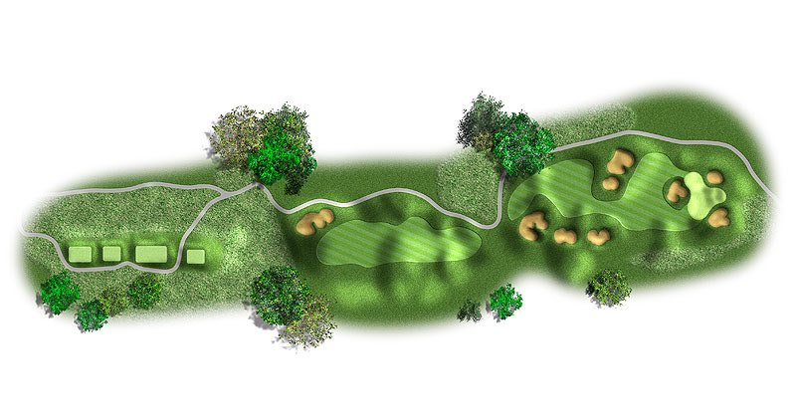
Many holes are straight, but notice how the land can have bumps and hills.

Slide 17
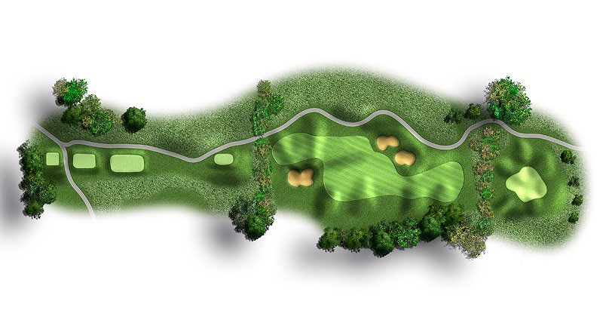
Many holes are straight, but notice how the land can have bumps and hills.

Slide 18
Not all holes are straight!
A curved hole such as this one is called a “dogleg”

Slide 19
Check out some other example of dogleg golf holes.

Slide 20
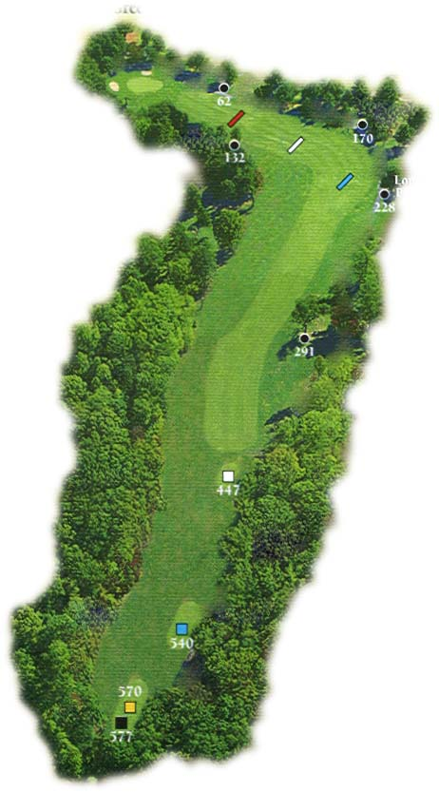
Dogleg hole

Slide 21
Dogleg hole

Slide 22
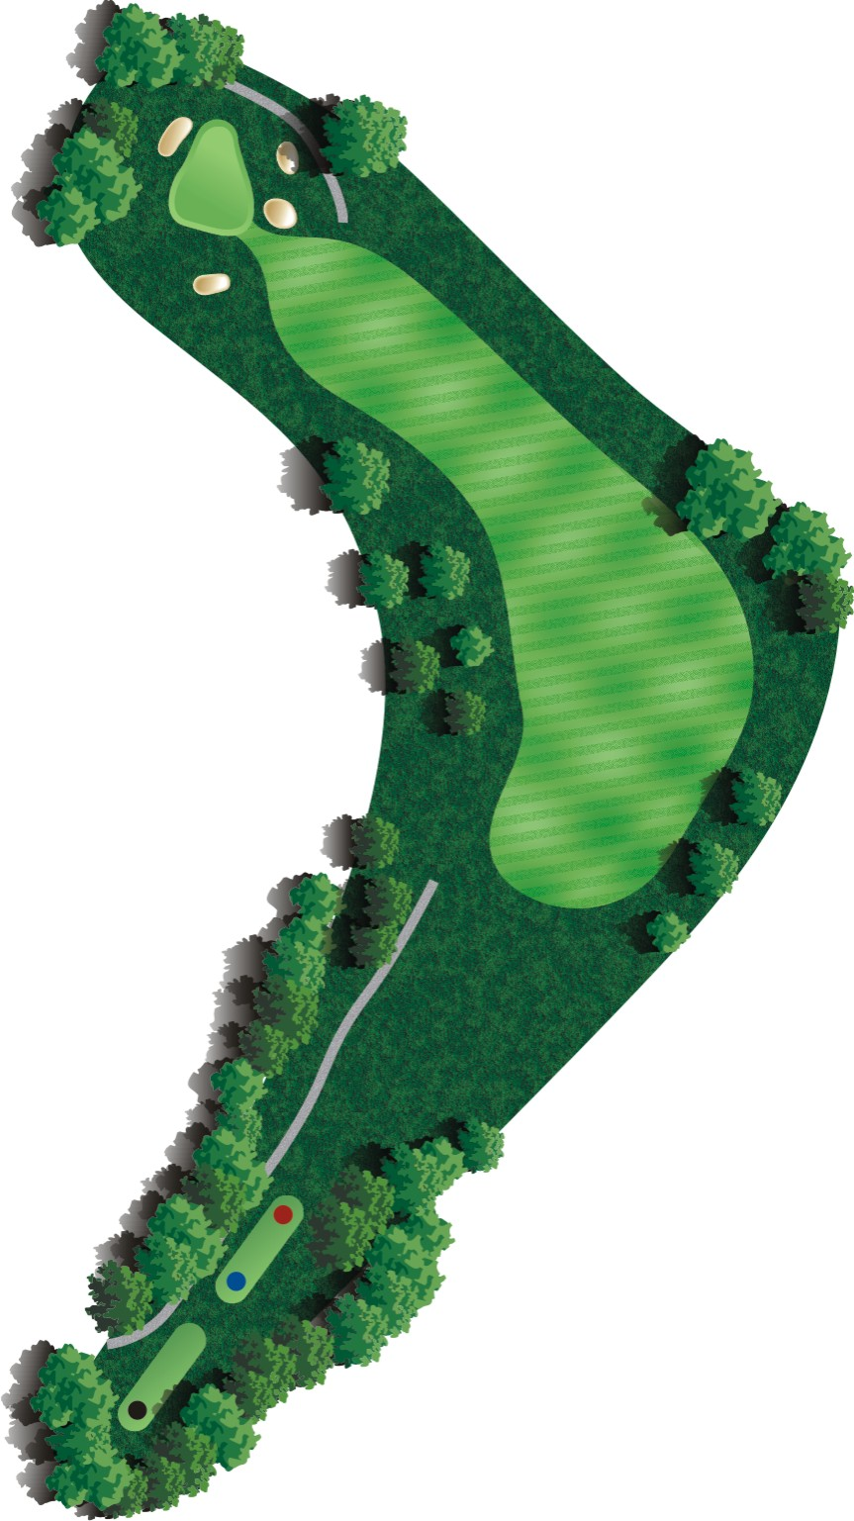
A risky player might try to beat a dogleg with one strong and accurate shot over trees or water.
But if your shot isn’t perfect,
you risk a penalty if your
ball goes out of bounds.
Most players
will aim for the fairway first,
then aim for the green on the next shot.

Slide 23
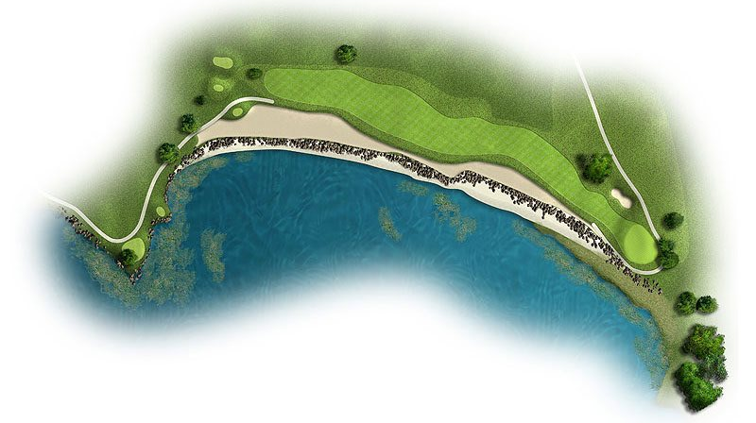
green
tee
Here is a dogleg over water.
Would you risk a long shot over the water to try to reach the green?

Slide 24
Check out the diagrams of many different types of golf holes from famous golf courses around the world.
Think about how you and your team might design your own unique golf hole.
Things to think about:
shape (straight, curved, dogleg...)
length
flat, hilly, downhill, uphill
hazards
Remember, the best golf holes should
not be TOO EASY or TOO HARD.

Slide 25
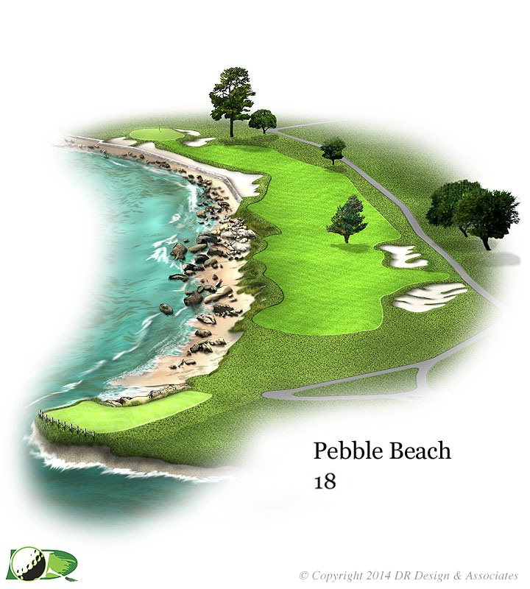

Slide 27
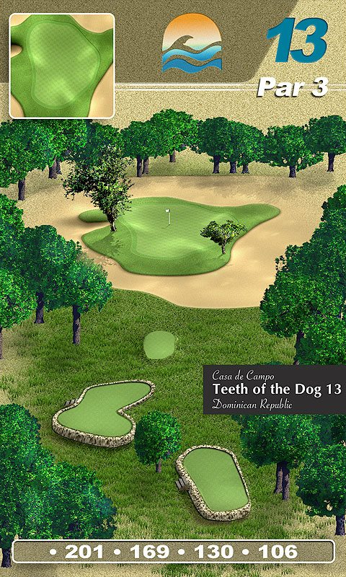

Slide 28
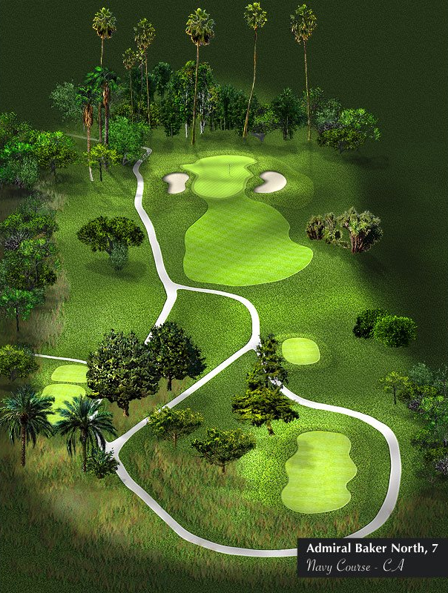

Slide 30
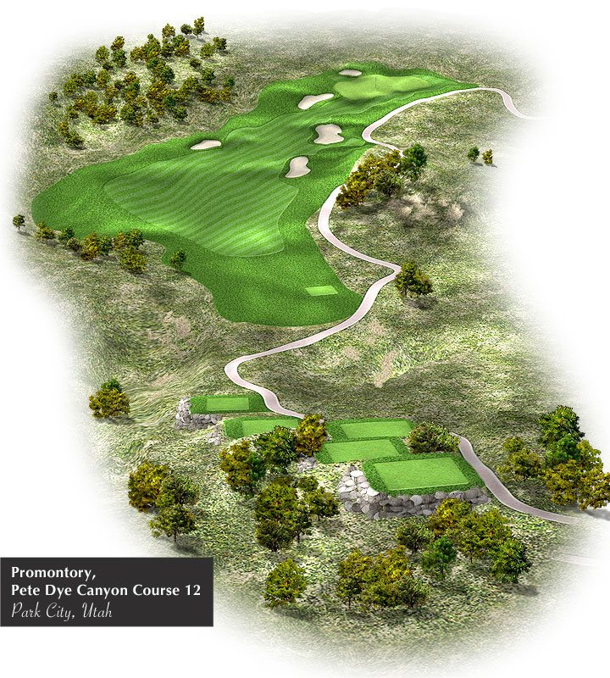

Slide 31
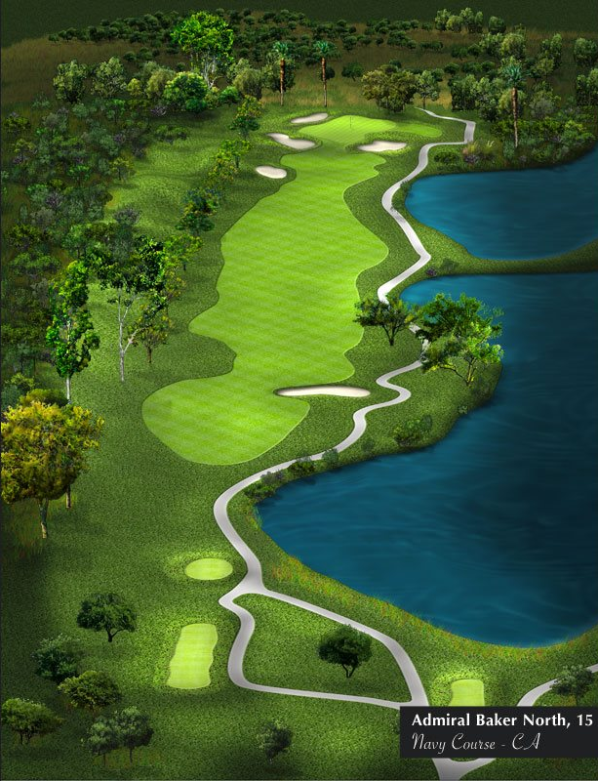

Slide 32
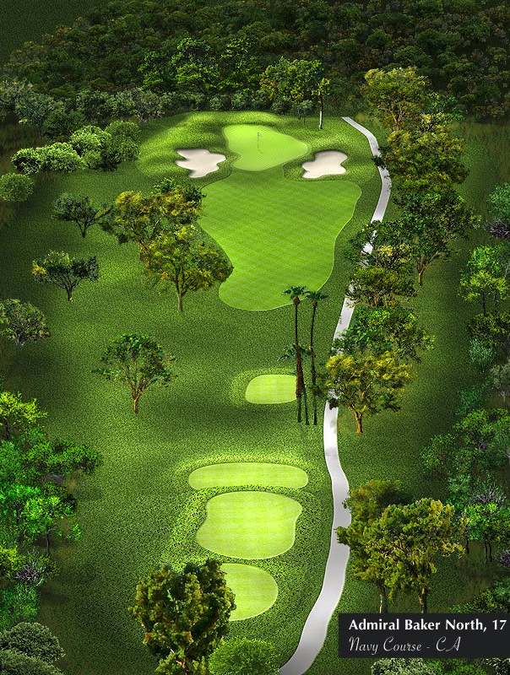

Slide 33
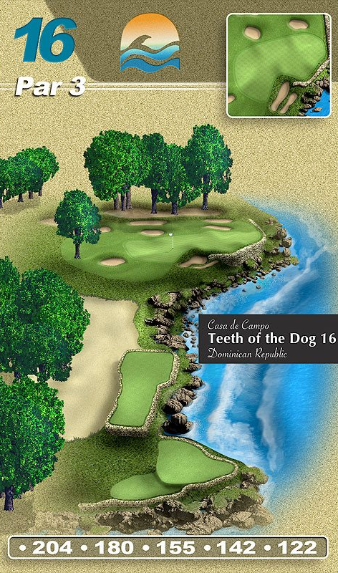

Slide 34
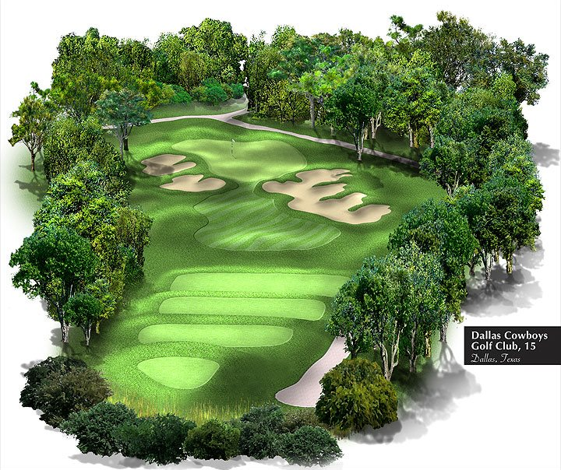

Slide 37
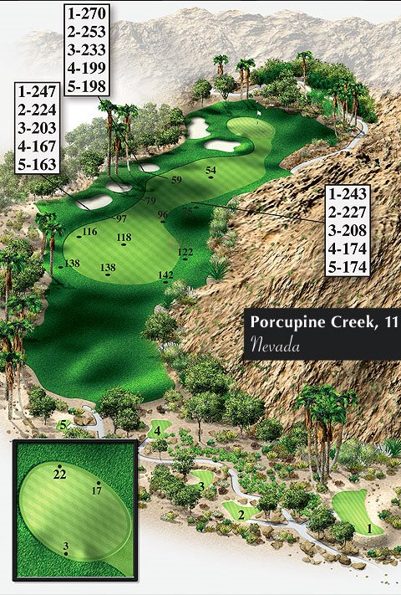

Slide 39
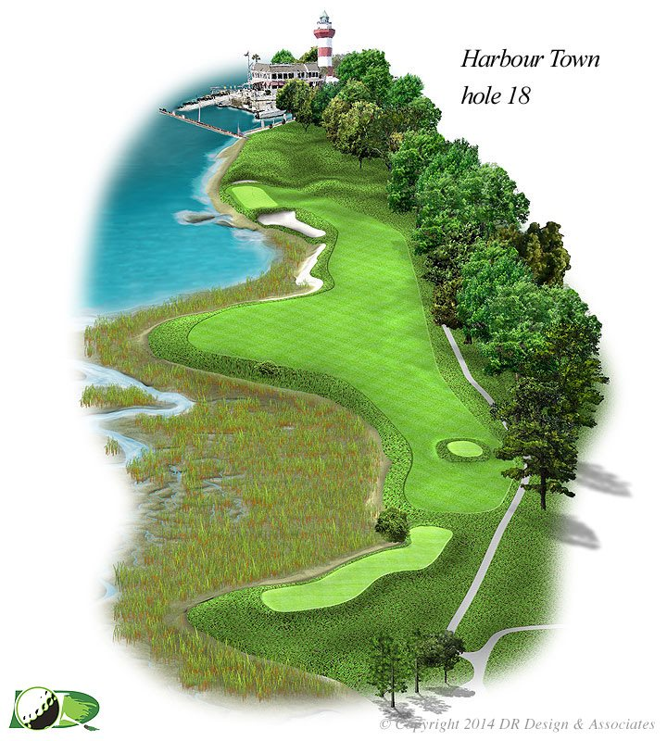

Slide 41
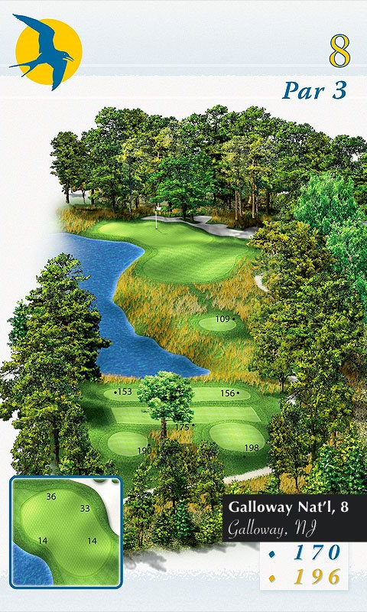

Slide 42
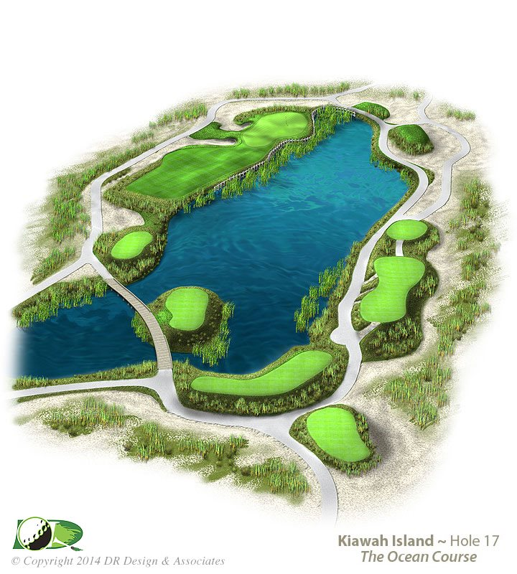

Slide 43
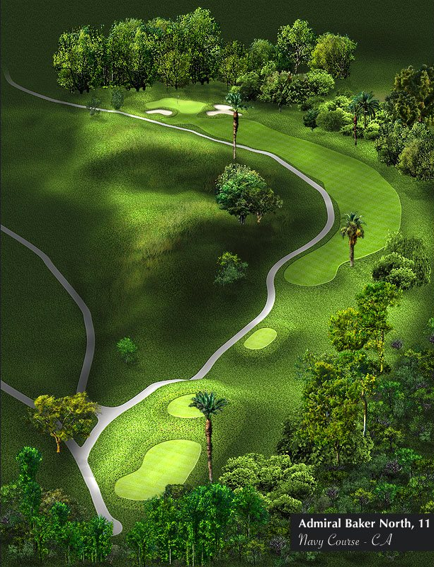

Slide 44
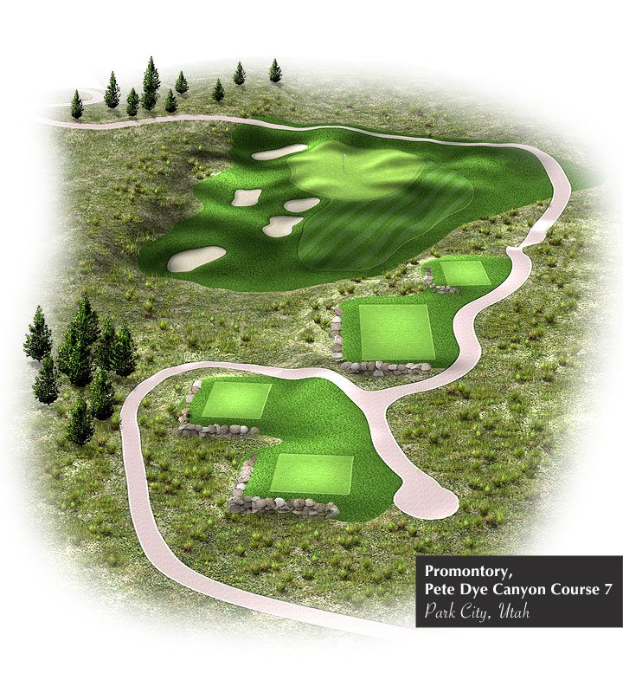

Slide 45
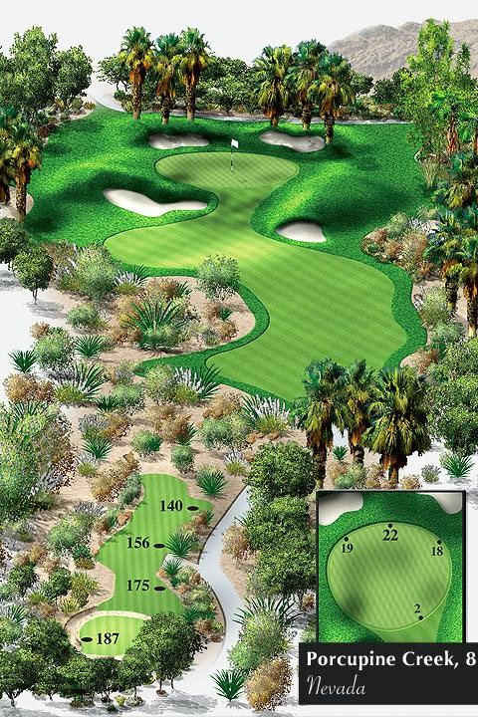

Slide 47
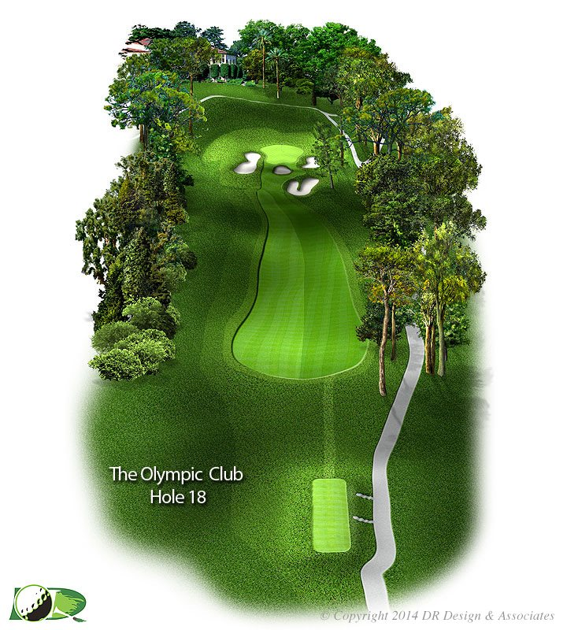

Slide 48
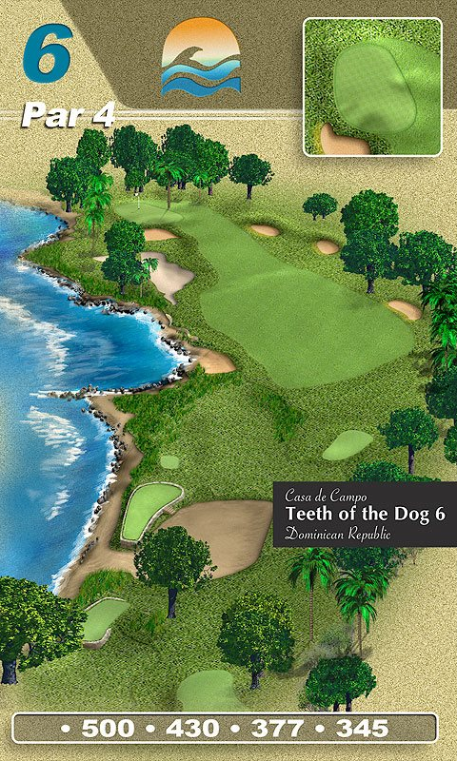

Slide 49
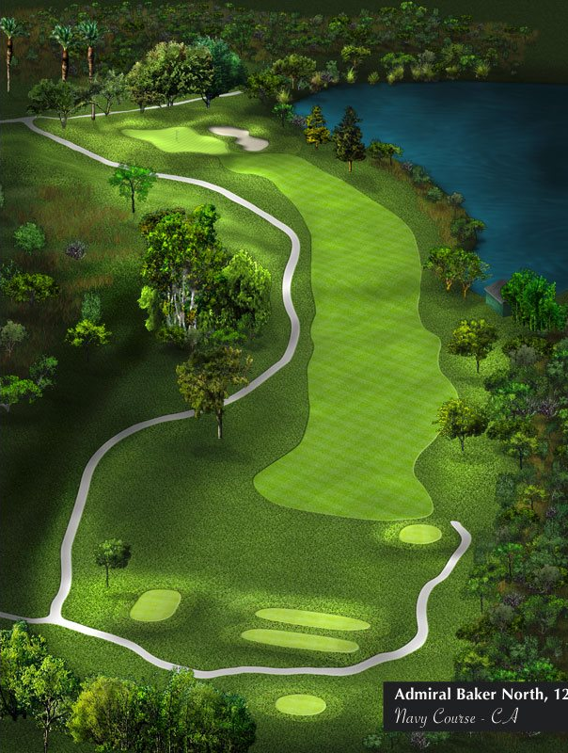

Slide 52
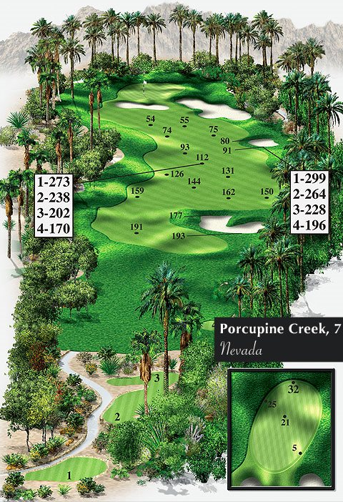

Slide 55
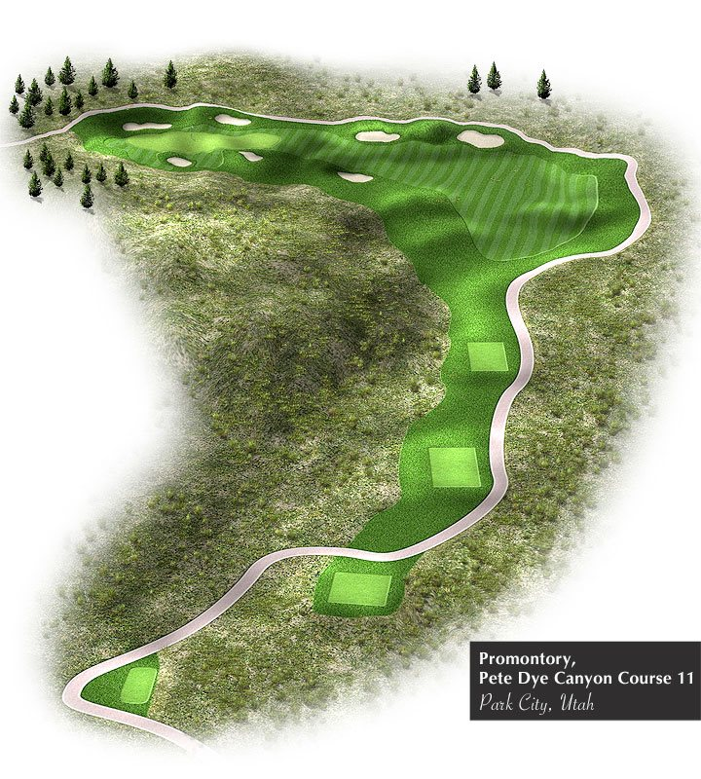

Slide 57
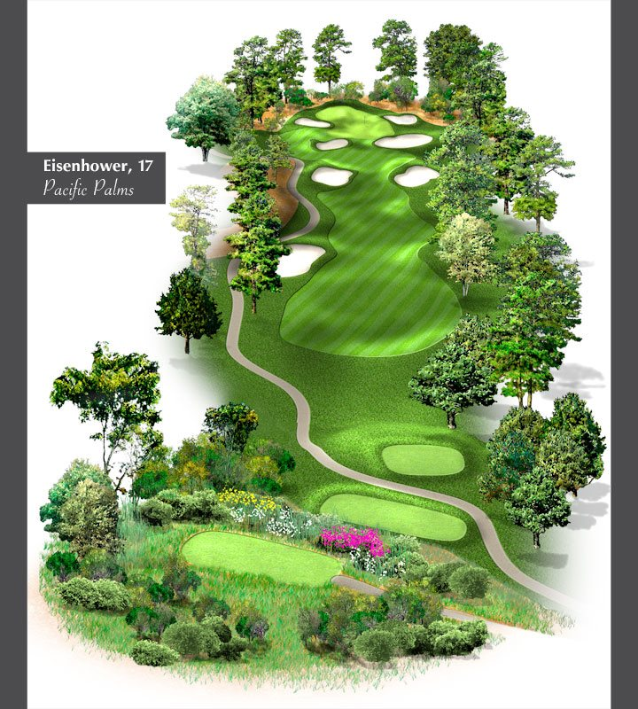

Slide 58
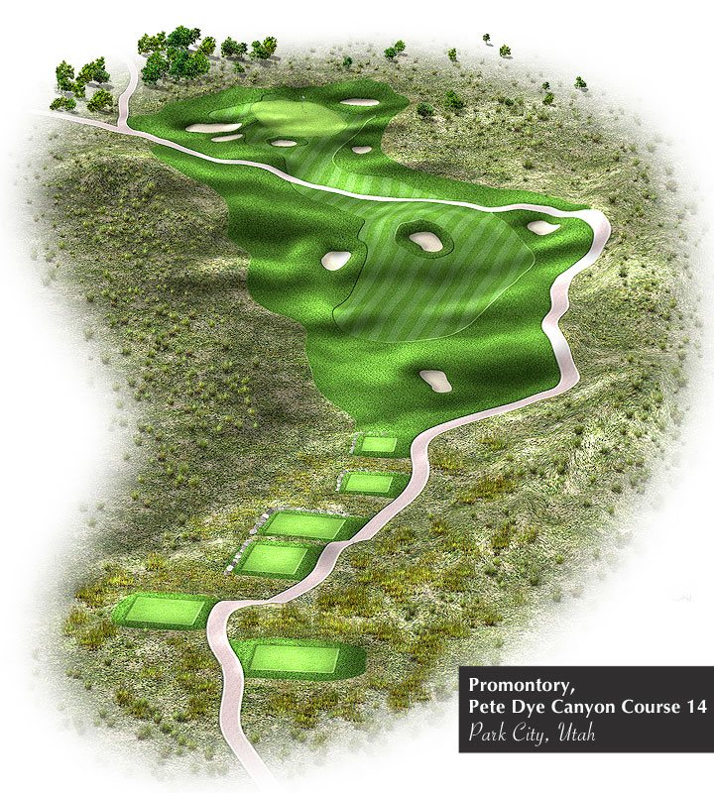

Slide 59
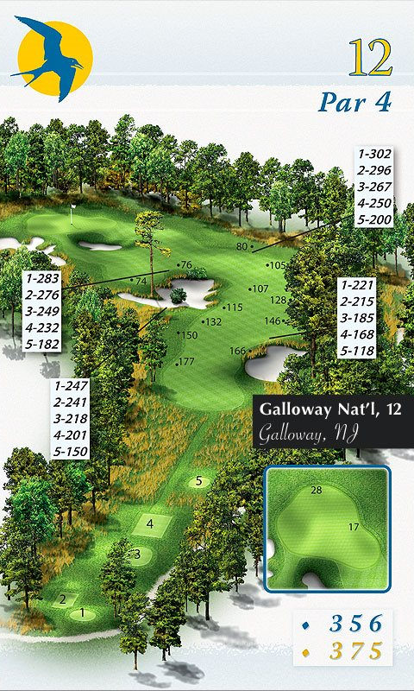

Slide 60
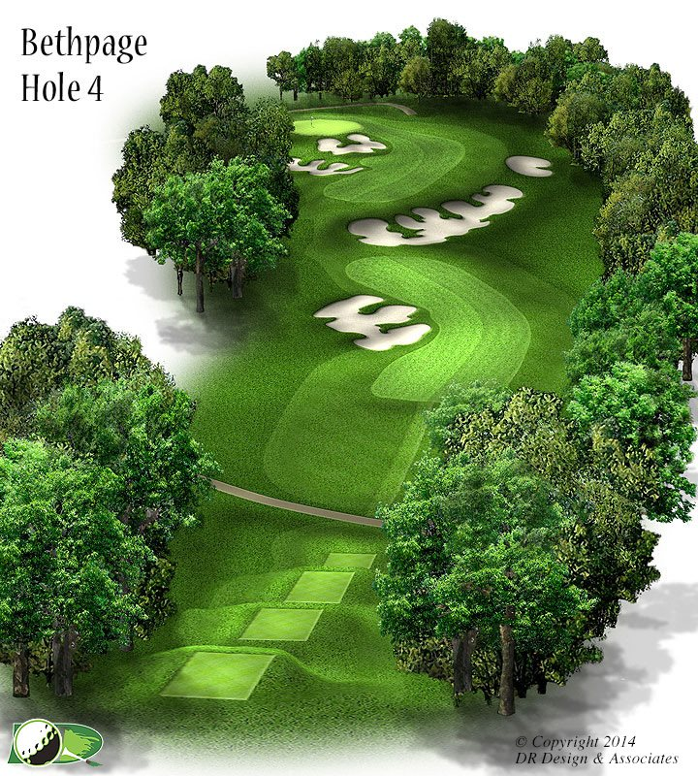

Slide 64
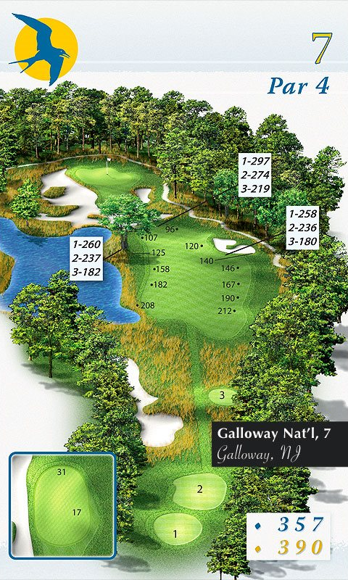

Slide 65
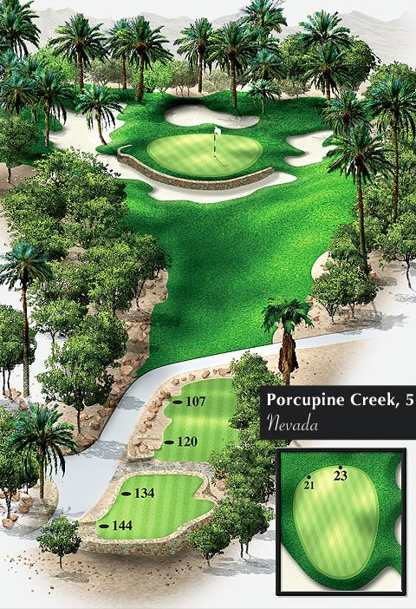

Slide 66
